Slide 1


Dr. AMBEDKAR INSTITUTE OF TECHNOLOGY
(An Autonomous Institute, Affiliated to Visvesvaraya Technological University, Belagavi, Accredited by NAAC, with ‘A’ Grade)
Near Jnana Bharathi Campus, Bengaluru – 560056
DEPARTMENT OF COMPUTER SCIENCE & ENGINEERING
STUDENT RESULT MANAGEMENT SYSTEM
PRESENTED BY:
YASH PATROT-1DA19CS191
PUNEETH S-1DA19CS199
UNDER THE GUIDANCE OF
MRS.VINUTHA H
Assistant Professor, Dept. of CSE,
Dr.AIT, Bengaluru – 56.

Slide 2
STUDENT RESULT MANAGEMENT SYSTEM
2022-MP86

Slide 3
TABLE OF CONTENTS
01
04
Introduction
System Architecture
02
05
Implementaion
Problem Statement & Objecive
03
06
Applications
Software Requirement Specification

Slide 4
INTRODUCTION
Student Result Management System using Python Django is a web Application project and by using this system we can manage Student result online.
With this system we not only manage student result but also we can manage exam data, subject data, student data and classes data.
The main purpose of developing this System is to reduce the manual errors and convert result system into computerized system.
This System is not only for student user but also assist the management which proceed with a large amount of pain to publish the Student results in usual conditions.
The students’ results are generated through a spreadsheet application and then printed on a paper, attached to a wall for declaration and then stored.

Slide 5
Problem Statement
The goal of the project is to create an application software that will decrease the amount of time spent manually maintaining Student, Result, Subject.

Slide 6
OBJECTIVE
The key objective of the Student Result Management System project is as follows:
It keeps track of all the information about the result, subject, and class etc.
Displays the information and description of the Student.
To improve the efficiency of student management,
It is in charge of keeping track of Class's data and transactions.
Organize and manage student information. The ability to edit, add, and update records
has increased, resulting in better resource management of student data.
Manage your class's information

Slide 7

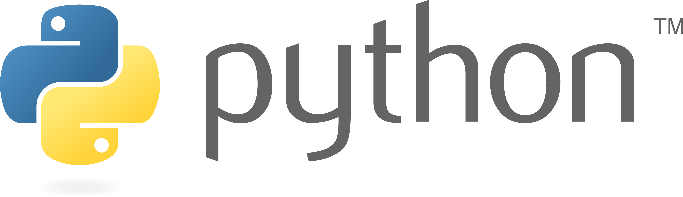
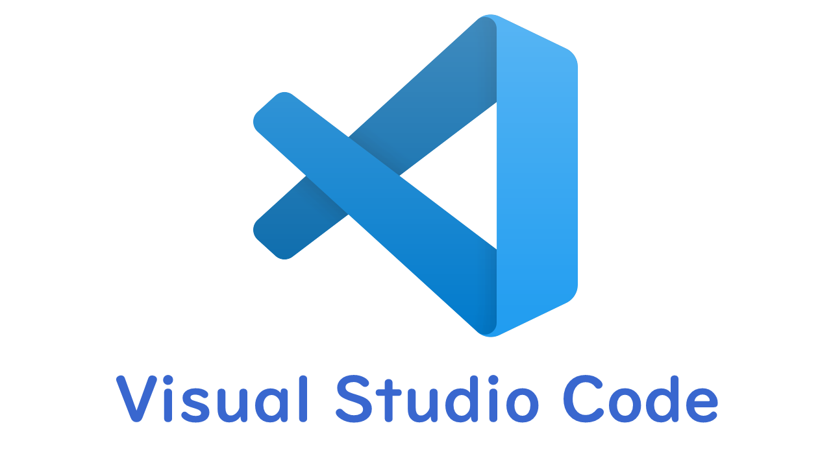
SOFTWARE REQUIREMENTS
Django is a Python-based web framework that allows you to quickly create efficient web applications. It is also called batteries included framework because Django provides built-in features for everything including Django Admin Interface, default database – SQLlite3, etc.
Python is a high-level, general-purpose and a very popular programming language. Python programming language (latest Python 3) is being used in web development, Machine Learning applications, along with all cutting edge technology in Software Industry.
Visual Studio Code is a code editor redefined and optimized for building and debugging modern web and cloud applications. Visual Studio Code is free and available on your favorite platform - Linux, macOS, and Windows.

Slide 8
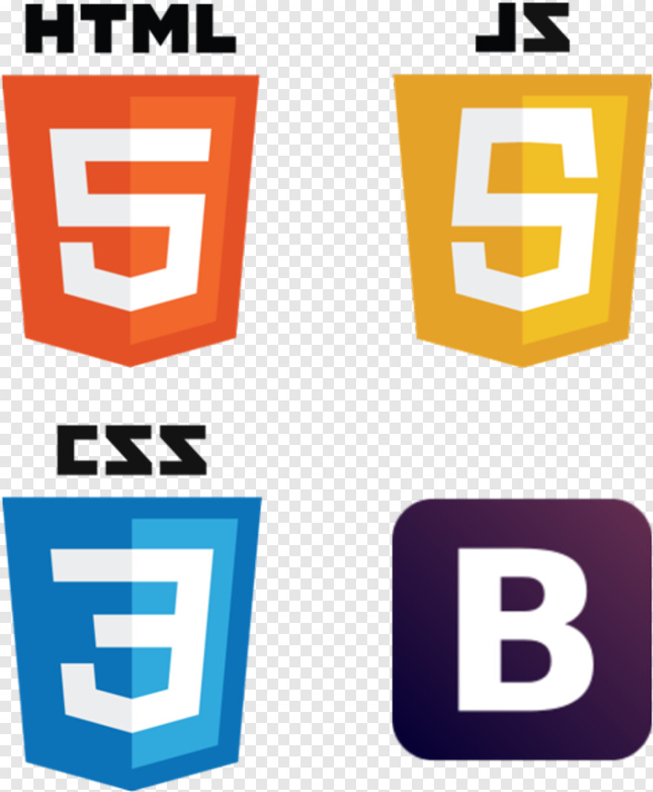

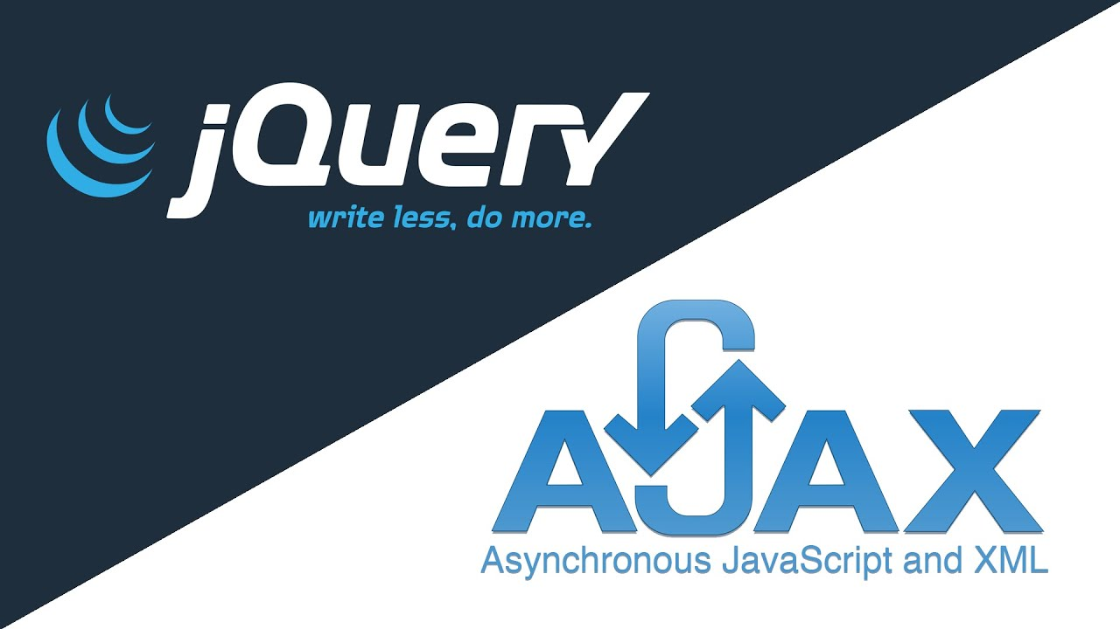

Slide 9
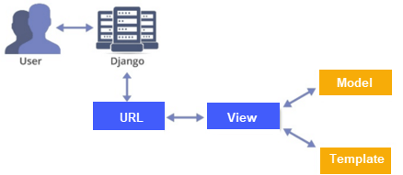
SYSTEM ARCHITECTURE
Django is based on MVT (Model-View-Template) architecture. MVT is a software design pattern for developing a web application.
MVT Structure has the following three parts –
Model: Model is going to act as the interface of your data. It is responsible for maintaining data. It is the logical data structure behind the entire application and is represented by a database (generally relational databases such as MySql, Postgres).
View: The View is the user interface — what you see in your browser when you render a website. It is represented by HTML/CSS/Javascript and Jinja files.
Template: A template consists of static parts of the desired HTML output as well as some special syntax describing how dynamic content will be inserted. How web requests are processed in a typical Django application

Slide 10
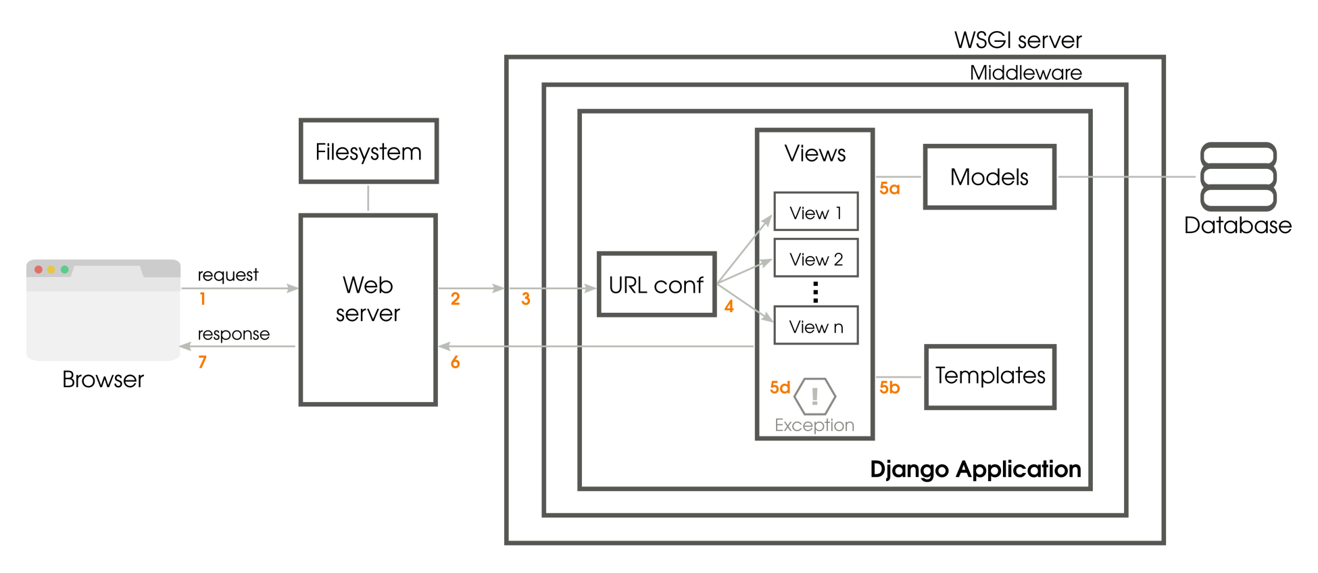
DJANGO WORKING

Slide 11
The preceding diagram shows the simplified journey of a web request from a visitor's browser to your Django application and back. The numbered paths are as follows: 1. The browser sends the request (essentially, a string of bytes) to your web server. 2. Your web server hands over the request to a Web Server Gateway Interface (WSGI) server or directly serves a file (a CSS file) from the filesystem. 3. Unlike a web server, WSGI servers can run Python applications. The request populates a Python dictionary called environ and, optionally, passes through several layers of middleware, ultimately reaching your Django application. 4. URLconf (URL configuration) module contained in the urls.py of your project selects a view to handle the request based on the requested URL. The request has turned into HttpRequest, a Python object. 5. The selected view typically does one or more of the following things: a. Talks to a database via the models b. Renders HTML or any other formatted response using templates c. Returns a plain text response (not shown) d. Raises an exception 6. The HttpResponse object gets rendered into a string, as it leaves the Django application. 7. A beautifully rendered web page is seen in your user's browser.

Slide 12
USE CASE DIAGRAMS
A Use Case Diagram is a graphical delineation of the cooperation’s among the components of a system that shows the connection between the user and diverse use cases in which the user is included.
Student use case

Slide 13
Admin use case

Slide 14
IMPLEMENTATION
This project is developed using the following:
▪ Python
▪ Django
▪ SQLite3
▪ HTML
▪ CSS
▪ JavaScript
▪ jQuery
▪ Ajax
▪ Google Material Icons
▪ Fontawesome
▪ Django Material Dashboard Template

Slide 15
FRONT END
HTML,CSS
JAVASCRIPT,BOOTSTRAP
GOOGLE MATERIAL ICONS
DJANGO MATERIAL DASHBOARD

Slide 16
BACKEND
PYTHON
DJANGO
SQLITE3

Slide 17
APPLICATIONS
The main benefit of using the exam result processing services is, of course, the automated processes that are handled via the Internet overcoming the downsides of human interventions.
Student Management System can be used by educational institutions to maintain their student records easily. Achieving this objective is difficult using the manual system as the information is scattered, can be redundant, and collecting relevant information may be very time-consuming. All these problems are solved by this project.
User-Friendly as the system is very interactive and can be easily operated.
Maintainability and reliability if the system is kept very thoroughly as all the records kept in the database have the backups and system can restore if there is power loss.

Slide 18
OUR TIMELINE
WEEK 3
WEEK 1
Planning
FINAL
VERSION
WEEK 2
WEEK 4
Implementation of technology
Physical Design
Which technology to use
Testing

Slide 19
REFERENCES
https://docs.djangoproject.com/en/4.0/
www.geeksforgeeks.com
www.youtube.com
www.sourcecodester.com
www.w3schools.com ww.geeksforgeeks.com
Presentation template by Slidesgo

Slide 20
THANKS!

